Slide 1
A NoSQL Database and CDN
for Video Delivery System
Team Members: Yani Jin, Xinyi Cai, Ryan Afranji

Slide 2
Content
System Overview
Implementation
Database
Web Servers
Load Balancer
Proxy Cache
Geo-aware DNS
Performance
Q & A

Slide 3
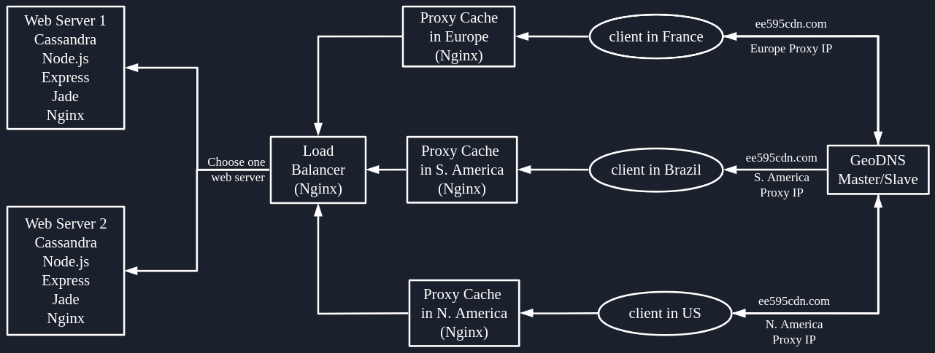
System

Slide 4
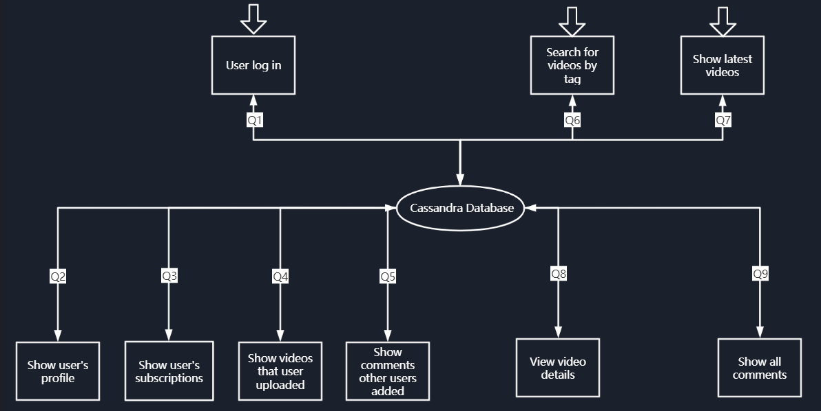
Database Design

Slide 5
Web Server
Cassandra runs as a process on local host

Slide 6
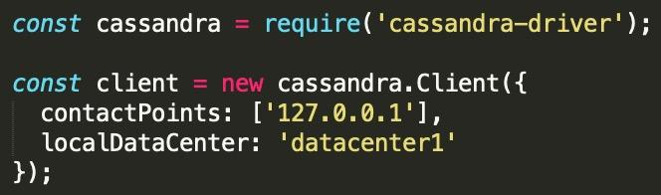
Web Server(cont.)
Node.js web server to support cassandra-driver

Slide 7
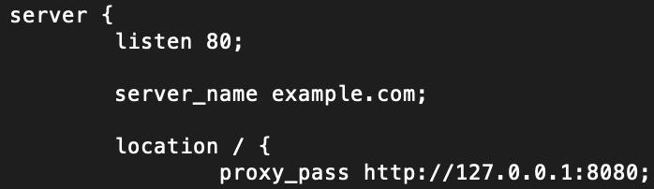
Web Server
Web server runs on local host on port 8080
Nginx conf -> routes local host web server to public ip

Slide 8
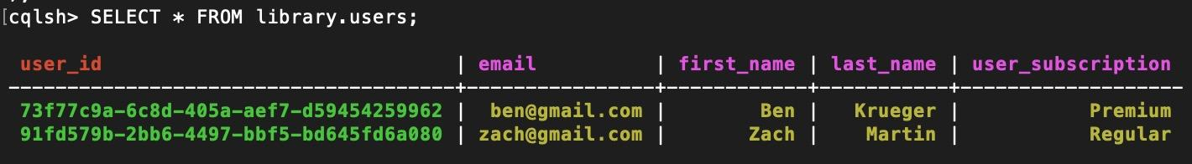
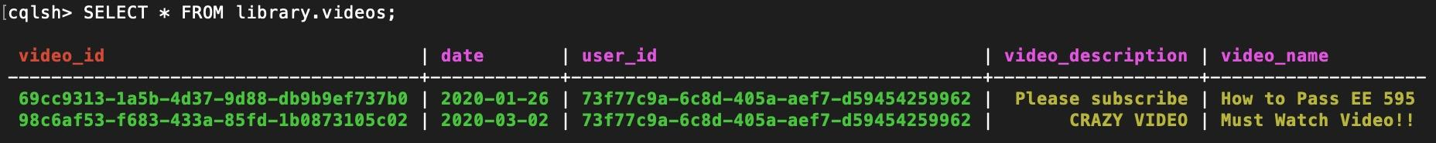
Web Server(cont.)
Samples from tables in the database

Slide 9
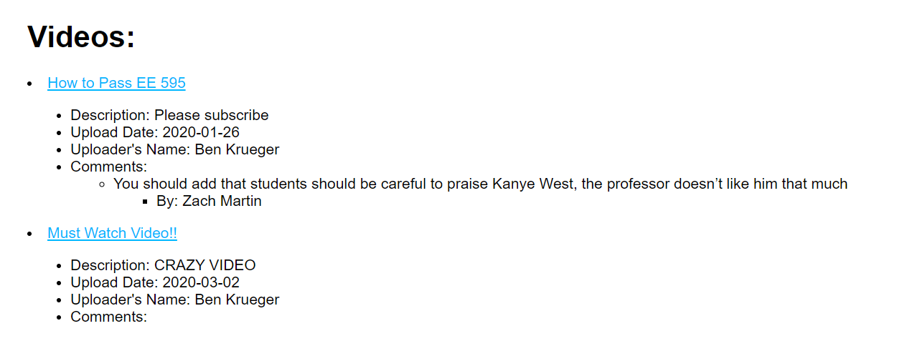
Web Server(cont.)

Slide 10
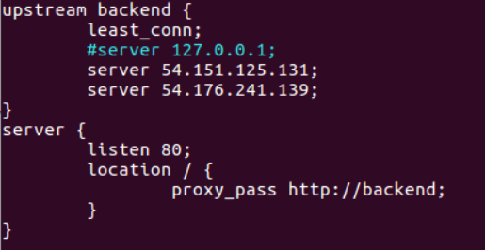
Load Balancer
Algorithm: Least connection
Upstream backend server IP address
Listening port
Proxy path

Slide 11
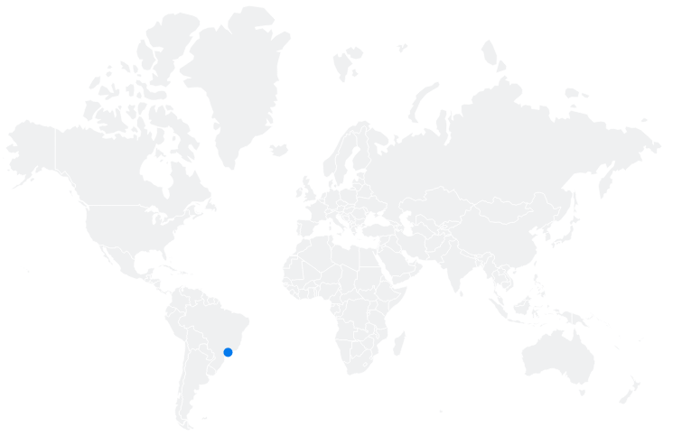
3 Proxies
| North America | South America | Europe|

Slide 12
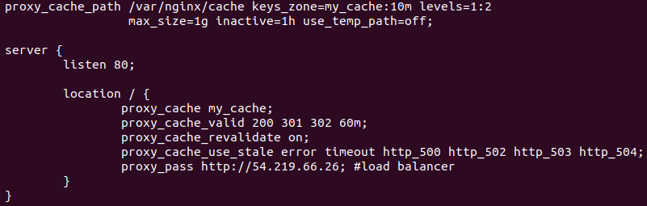
Proxy Cache
Upstream Server
Shared Memory Zone
Cache Directory
Cache Policies
What content do we cache?
How long does the cached content stay in hard drive?
What if the cached content is expired?
What if there was a server error or connection error when fetching?

Slide 13
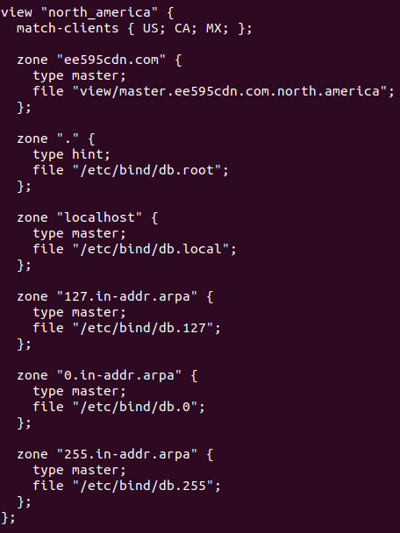
Geo-aware DNS
BIND
Master and Slave
Master -> transfer zone -> slave
Geo-Aware
Access Control List (ACL)
View clause
Zone files
Connect Domain Name with DNS

Slide 14
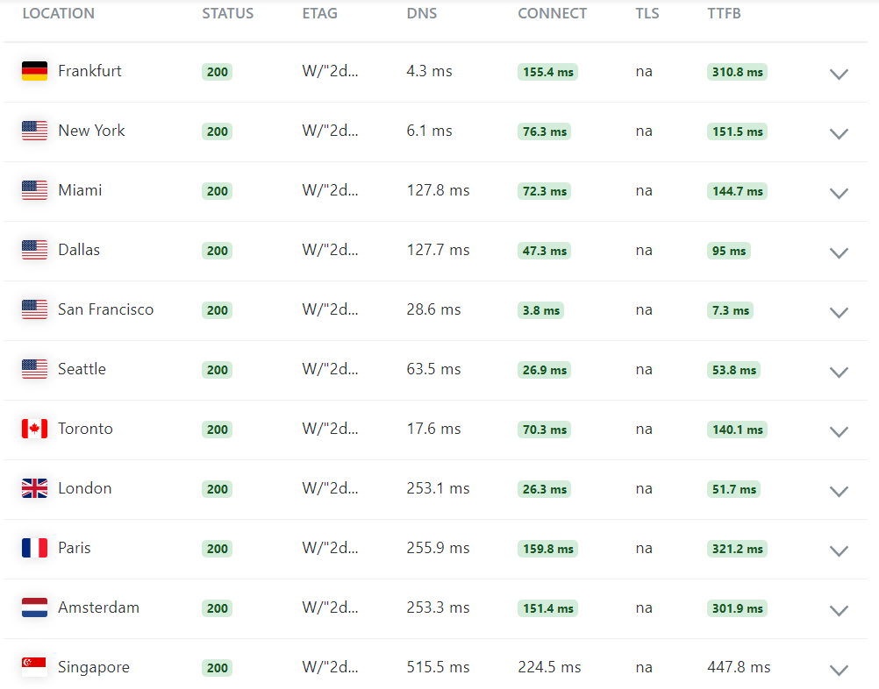
Performance
Status
DNS
Connect
TLS
TTFB

Slide 15
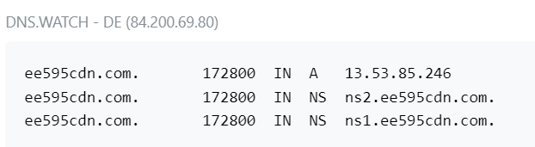
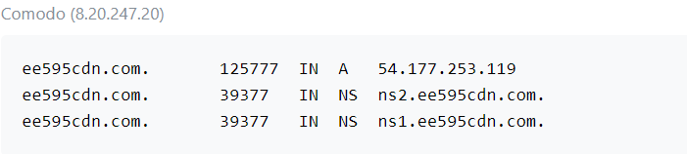
Performance
DNS checker
Proxy Cache in Europe
Proxy Cache in N.America

Slide 16
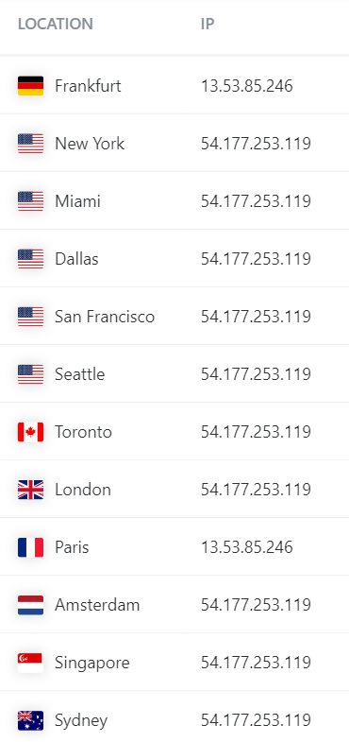
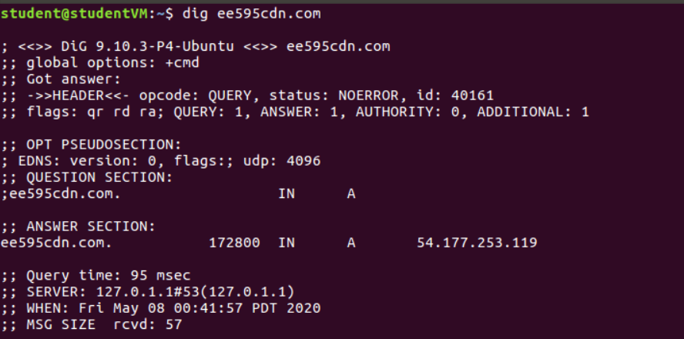
Performance

Slide 17
Performance
CDN with Geo-aware DNS
CDN without Geo-aware DNS

Slide 18
Q & A

